Slide 1
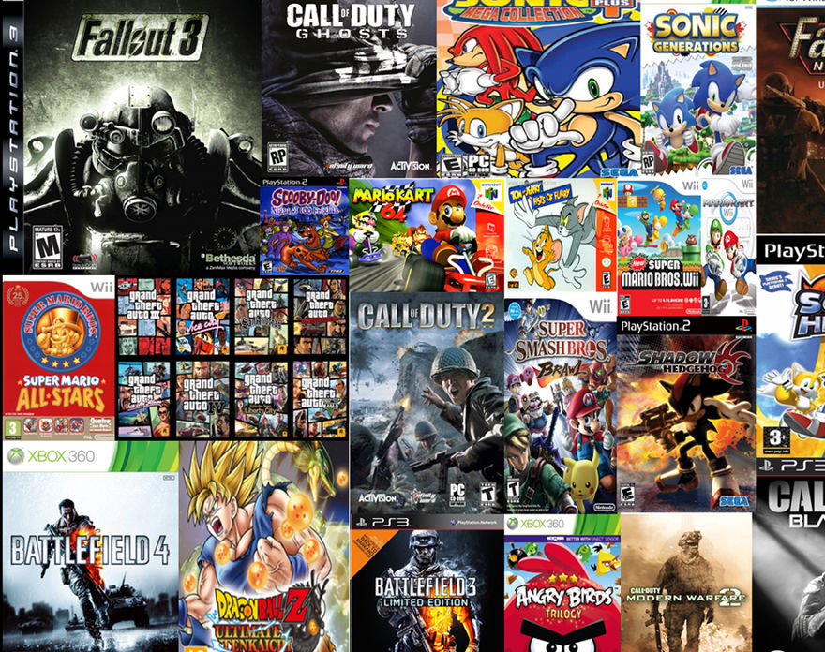
North American Video Games Sales
By Giovanni Hermosillo

Slide 2
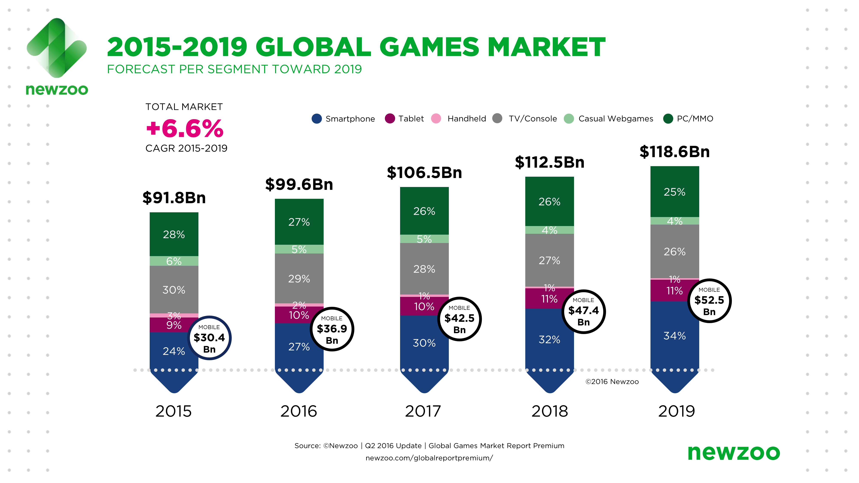
Introduction
Company A wants to get into the video game industry by starting a separate division for it and selling video games in North America.

Slide 3

Problem
The company has no experience producing or selling video games. What are the most important factors that determine sales performance?

Slide 4
Approach
Develop a model that will predict video games sales in North America
Discover what were the most important features for the model
Use video games sales data from the past 20 years as a basis for model

Slide 5
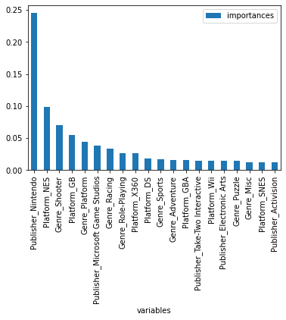
Most important factors

Slide 6
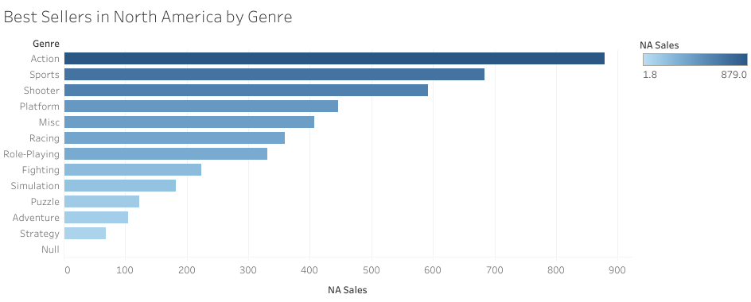

Slide 7
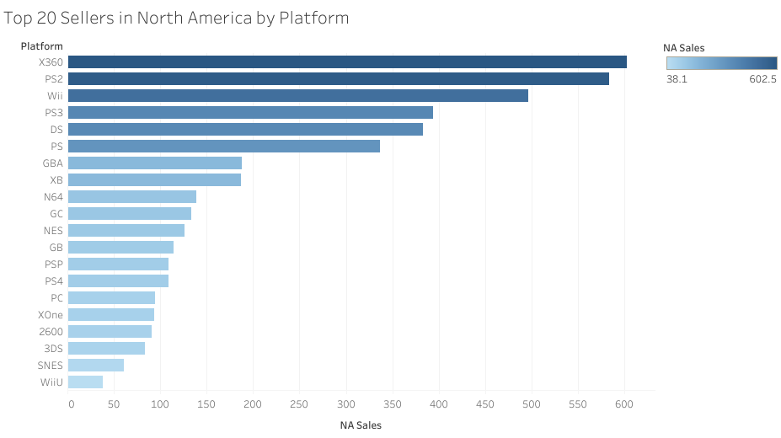

Slide 8
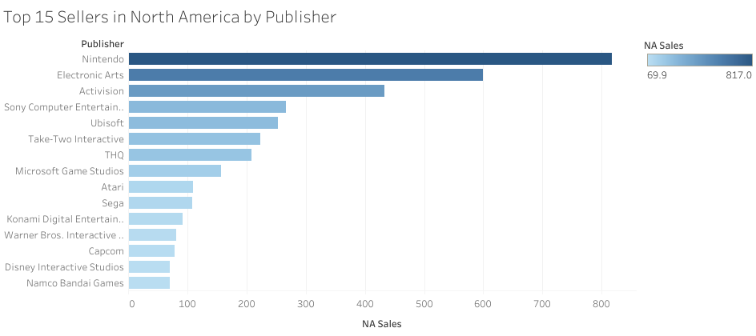

Slide 9
Model Functions
Takes in North American video game sales performance for the last 20 years
Predicts the sales performance of a video game based on its genre, platform, and publisher

Slide 10
Model Specs
Random Forest Regressor w/ Randomized Search CV
Features:
X = Genre, Platform, Publisher
Y = North American Sales
Parameters:
n_estimators: 70
min_samples_split: 10
min_samples_leaf: 2
max_features: sqrt
max_depth: 80
bootstrap: True

Slide 11
Model Performance
Mean Absolute Error (MAE): 0.3427
Mean Squared Error (MSE): 1.4258
Root Mean Squared Error (RMSE): 1.1941

Slide 12

Recommendations
1st recommendation: use Model 1 as the basis for developing a marketing strategy
2nd recommendation: further develop the model through research

